Slide 1
Introduction

Slide 2
Introduction to
COBOL

Slide 3
COBOL
COBOL is an acronym which stands for
Common Business Oriented Language.
The name indicates the target area of COBOL applications.
COBOL is used for developing business, typically file-oriented, applications.
It is not designed for writing systems programs. You would not develop an operating system or a compiler using COBOL.

Slide 4
COBOL Coding Rules
All COBOL programs must be structured in this way:
Columns 1 - 6: Used for sequence numbers or page and line numbers. This is optional and was previously used for sequence checking when programs were punched into cards.
Column 7: Used for continuations, comments, or starting a new page. Placing a * in column 7 denotes that line as being a comment. Placing a / in column 7 causes the printer to skip to a new page when printing the source listing, and this column can also be used to continue nonnumeric literals.
Columns 8 - 11: Known as "Area A"; entries such as DIVISION, SECTION, and paragraph-names must begin in Area A.
Columns 12 - 72: Known as "Area B"; most COBOL entries including PROCEDUREDIVISION statements and sentences are coded in Area B. Columns 73 - 80: Used for program identification (this is optional.)

Slide 5
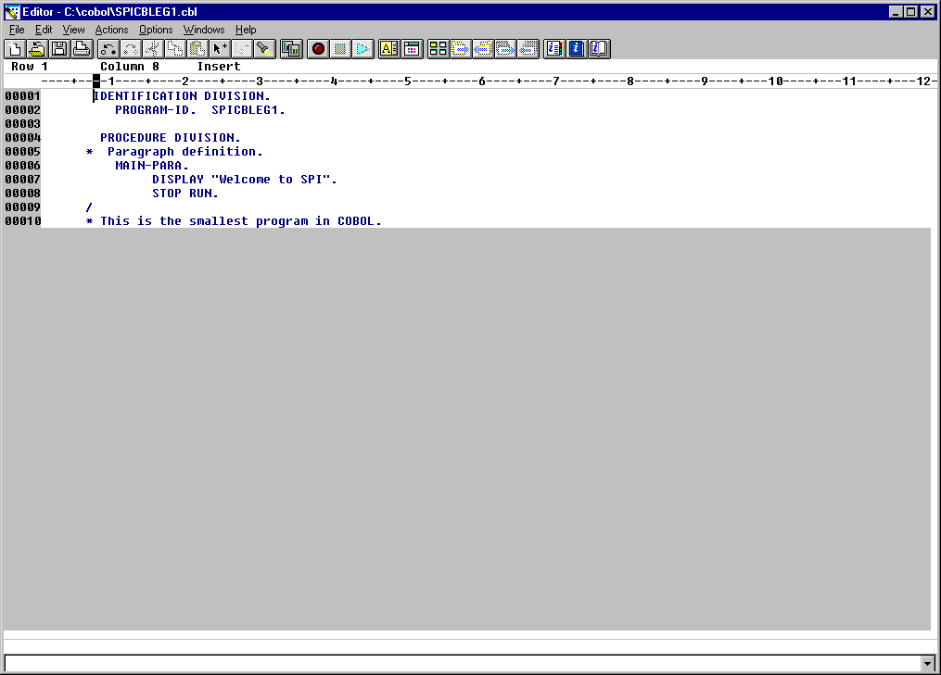
Start/ Programs/ VisualAge COBOL for Windows/ Program Editor

Slide 6
Four Divisions
Identification Division
  This DIVISION is used to supply information about the program to the programmer and to the compiler.
Environment Division
  This DIVISION describes to the compiler the environment in which the program will run.
Data Division
  As the name suggests, the DATA DIVISION is used to provide the descriptions of most of the data to be processed by the program.
Procedure Division
  This division contains all instructions necessary for reading the input, processing it, and creating the desired output.
Although some of the divisions may be omitted the sequence in which the DIVISIONS are specified is fixed and must follow the pattern shown above.

Slide 7
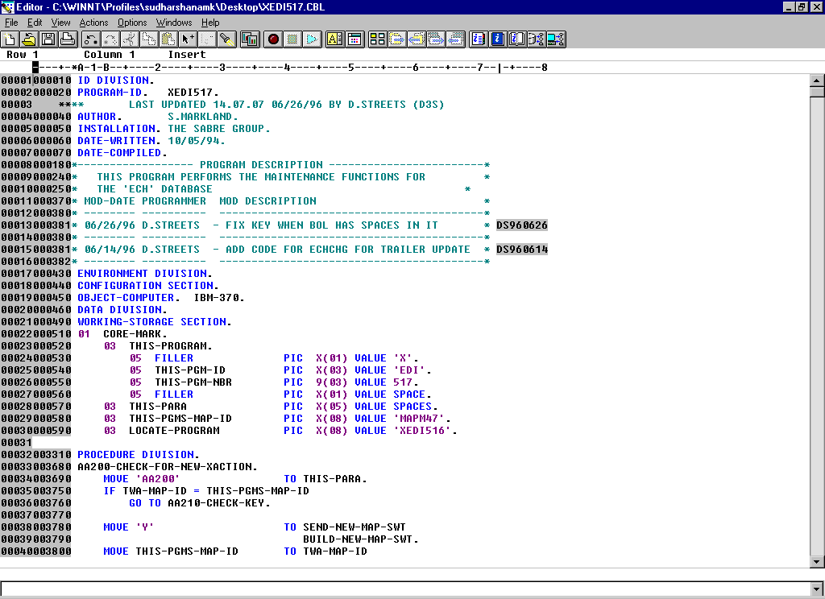
Typical COBOL Program

Slide 8
Cobol Program
Here we have to explain
How to Code Cobol Pgm.
To Save a Cobol Pgm.
To compile a Cobol Pgm.
To Run a Cobol Pgm.
And Something related to Cobol Editor.

Slide 9
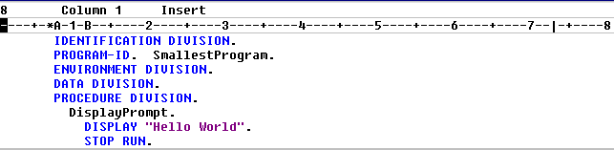
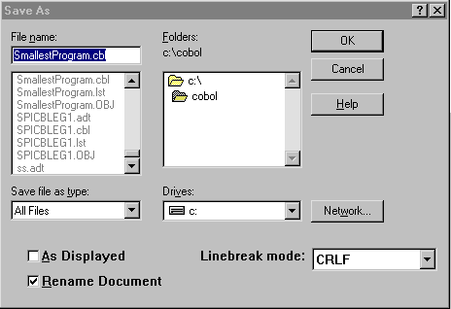
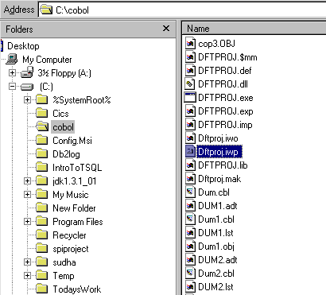
Program-1
To display “Welcome to Spi”

Slide 10
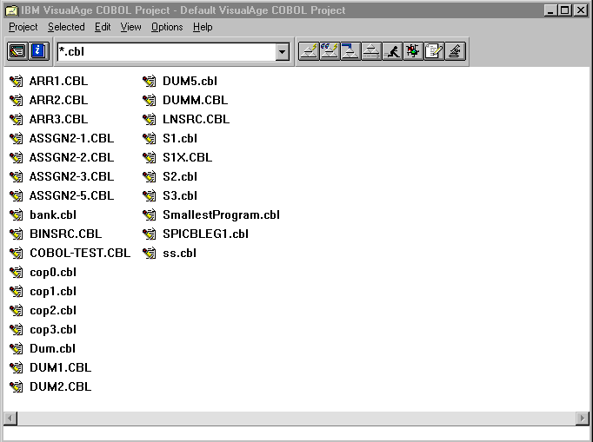
Compile Ctrl + Shft + C
Run Ctrl + Shft + R

Slide 11
IDENTIFICATION DIVISION.
The purpose of the IDENTIFICATION DIVISION is to provide information about the program to the programmer and to the compiler.
Most of the entries in the IDENTIFICATION DIVISION are directed at the programmer and are treated by the compiler as comments.
An exception to this is the PROGRAM-ID clause. Every COBOL program must have a PROGRAM-ID. It is used to enable the compiler to identify the program.
There are several other informational paragraphs in the IDENTIFICATION DIVISION but we will ignore them for the moment.

Slide 12
The DATA DIVISION.
The DATA DIVISION is used to describe most of the data that a program processes.
The DATA DIVISION is divided into two main sections;
  FILE SECTION.
  WORKING-STORAGE SECTION.
The FILE SECTION is used to describe most of the data that is sent to, or comes from, the computer’s peripherals.
The WORKING-STORAGE SECTION is used to describe the general variables used in the program.

Slide 13
PROCEDURE DIVISION.
The PROCEDURE DIVISION is where all the data described in the DATA DIVISION is processed and produced. It is here that the programmer describes his algorithm.
The PROCEDURE DIVISION is hierarchical in structure and consists of Sections, Paragraphs, Sentences and Statements.
Only the Section is optional. There must be at least one paragraph, sentence and statement in the PROCEDURE DIVISION.
In the PROCEDURE DIVISION paragraph and section names are chosen by the programmer. The names used should reflect the processing being done in the paragraph or section.

Slide 14
Sections
A section is a block of code made up of one or more paragraphs.
A section begins with the section name and ends where the next section name is encountered or where the program text ends.
A section name consists of a name devised by the programmer or defined by the language followed by the word SECTION followed by a full stop.
  First SECTION.
  FILE SECTION.

Slide 15
Paragraphs
Each section consists of one or more paragraphs.
A paragraph is a block of code made up of one or more sentences.
A paragraph begins with the paragraph name and ends with the next paragraph or section name or the end of the program text.
The paragraph name consists of a name devised by the programmer or defined by the language followed by a full stop.
    Main-Para.
    Exit-Main.

Slide 16
Sentences and Statements.
A paragraph consists of one or more sentences.
A sentence consists of one or more statements and is terminated by a full stop.
  MOVE 21 TO VarRate
  COMPUTE VarAmount = ProductCost * VatRate.
  DISPLAY "Enter name " WITH NO ADVANCING
  ACCEPT StudentName
  DISPLAY "Name entered was " StudentName.
A statement consists of a COBOL verb and an operand or operands.
SUBTRACT Tax FROM GrossPay GIVING NetPay
READ StudentFile
  AT END SET EndOfFile TO TRUE
  END-READ

Slide 17
A Full COBOL program.
IDENTIFICATION DIVISION.
PROGRAM-ID. SPICBLEG2.
AUTHOR. Sudharshana.
DATA DIVISION.
WORKING-STORAGE SECTION.
01 WS-NAME PIC X(20).
01 WS-SAL PIC 9(6).
PROCEDURE DIVISION.
MAIN-PARA.
DISPLAY "Employee Name = " WITH NO ADVANCING.
ACCEPT WS-NAME.
DISPLAY "Employee SALARY = " WITH NO ADVANCING.
ACCEPT WS-SAL.
DISPLAY "Employee Name = ", WS-NAME.
DISPLAY "Employee SALARY = ", WS-SAL.
STOP " "
STOP RUN.

Slide 18
Structure of COBOL programs.
Program
Divisions
Section(s)
Paragraph(s)
Sentence(s)
Statement(s)

